Slide 1
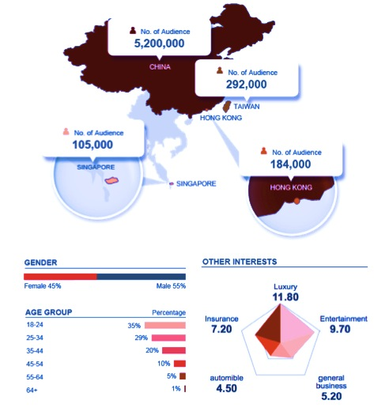
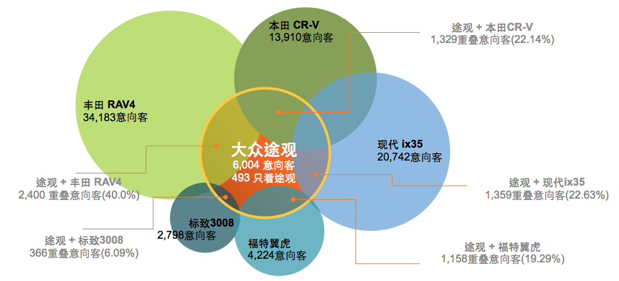
Brand Clients
Brand Competitive Analysis
Data Support for Sales Pitch
The process:
Input the client name and competitor names, a bubble chart show
You may select any bubble or the intersected area between your client and their competitor, then the following information will be shown side by side:
Geo-graphics
Demographics (i.e. Gender, Age Group & Income Range)
Techno-graphics
Psycho-graphics
A Custom Audience Group can be created basing on your selection for audience buying campaign
1

Slide 2
Cosmetics - Lancome
Estee Lauder
16,000
Lancome x Estee Lauder:
3,000 (20%)
Lancome x Guerlain:
2,000 (13.33%)
Shiseido
18,000
Lancome
15,000,
7,900 look for Lancome only
Guerlain
6,000
Sisley
4,000
Chanel
8,000
Lancome x Shiseido:
1,000 (6.67%)
Lancome x Sisley:
300 (2%)
Lancome x Chanel:
800 (5.33%)

